Slide 1
Overview
Airline booking process
March 2009

Slide 2
Agenda
Overview of airline booking process
Overview of systems involved
Introduction to booking engines

Slide 3
Overview of airline booking process

Slide 4
Booking process
The process of searching for and booking of available airline seats
Involves multiple steps, executed one by one

Slide 5
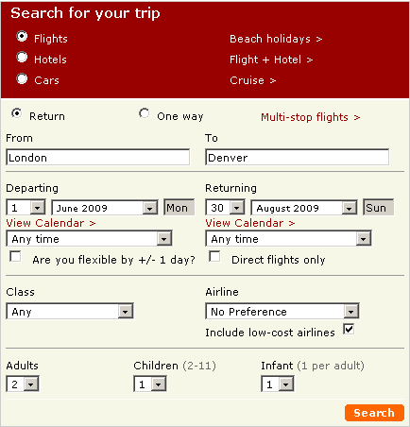
Booking process (continued…)
Step 1: Specify search parameters
Acknowledgment: The image above is from the actual booking process on http://ww.opodo.co.uk
Notes:
Note the search parameters shown in the red coloured rectangle.

Slide 6
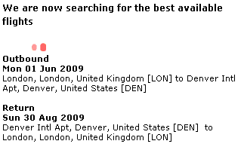
Booking process (continued…)
Step 2: Search for route, schedule and availability
Acknowledgment: The image above is from the actual booking process on http://ww.opodo.co.uk
Notes:
Key points
The customer has provided just an origin, a destination, travel dates and passenger types. The system takes these parameters and applies the following steps:
Routing: There can be hundreds or even thousands of possible routes between the origin and destination, based on how far apart they are, intermediate airports between them, etc. The first step is therefore to establish possible routes between the origin and the destination. A route is a potential way of getting from the origin to the destination via other airports.
Schedule: Once possible routes have been determined, flight schedules are consulted between the origin and the first intermediate airport, between all the intermediate airports and between the last intermediate airport and the destination. This yields potential flights that the customer can take to get from the origin to the destination. Many routes may get eliminated at this step since there may not be any viable flights for those routes.
Availability: Once flight data is available, seat availability is determined on the flights. Many schedules may get eliminated at this step since seats may not be available on certain flights.

Slide 7
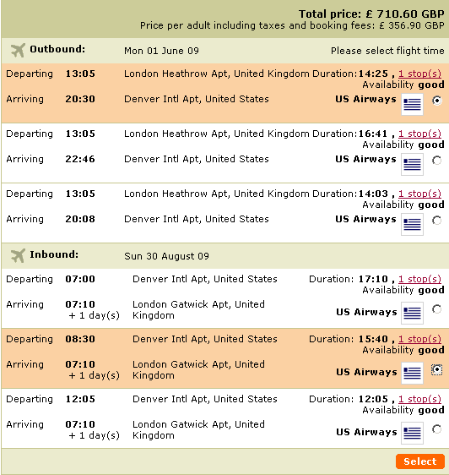
Booking process (continued…)
Step 3: Choose fare
Acknowledgment: The image above is from the actual booking process on http://ww.opodo.co.uk
Notes:
Notice the message displayed within the red coloured rectangle.

Slide 8
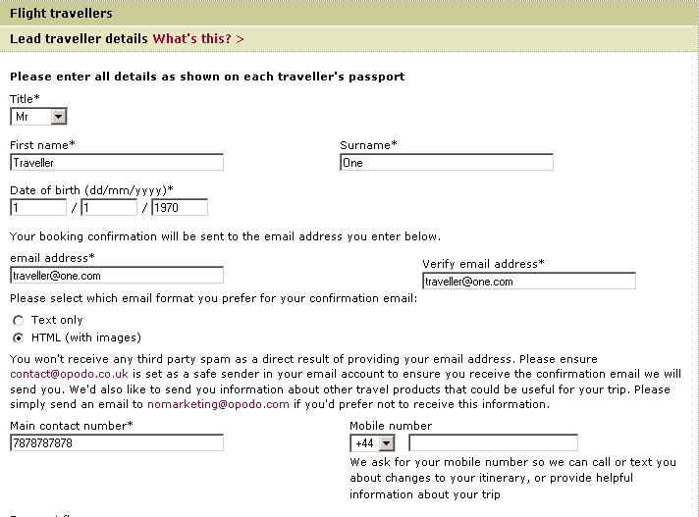
Booking process (continued…)
Step 4: Provide passenger details
Acknowledgment: The image above is from the actual booking process on http://ww.opodo.co.uk

Slide 9
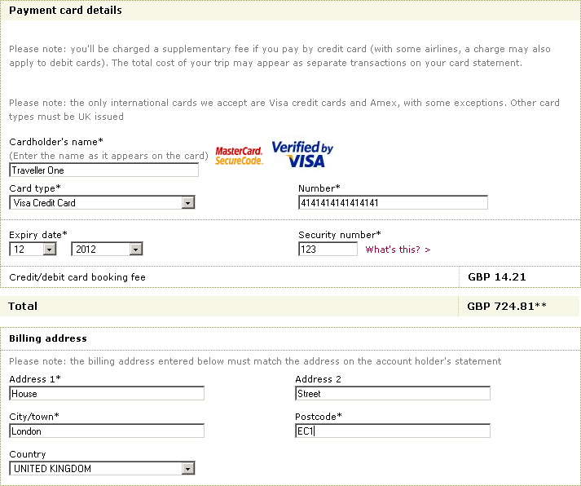
Booking process (continued…)
Step 5: Pay and confirm
Acknowledgment: The image above is from the actual booking process on http://ww.opodo.co.uk

Slide 10
Airline booking process and systems involved

Slide 11
Systems involved
Route
search
Schedule
search
Availability
search
Fare
search
Passenger
confirmation
Payment
Stage
Location database (read)
Route maps (read)
Schedule database (read)
Availability database (read)
Fare database (read)
Fare database (read)
Availability database (write)
Reservation database (write)
Reservation database (write)
GDS
Frequent flyer database (read)
Availability database (write)
Reservation database (write)
Frequent flyer database (write)
Availability database (write)
Reservation database (write)
Airline
CRS
Notes:
How the various systems are affected will be explained in greater detail on the slides to follow.

Slide 12
Route search
Objective: To find potential routes between the origin and the destination locations
Databases read
  GDS location database
Databases modified
  None
Uses graph algorithms to determine potential routes between the origin and destination location
Location database is provided by International Air Transport Association (IATA)
Locations are identified by a three or four letter IATA code (e.g. DEL, LON)

Slide 13
Schedule search
Objective: To determine all available scheduled flights on the possible routes determined between the origin and destination locations
Databases read
  GDS schedule database
Databases modified
  None
Schedule information is provided by airlines and includes flight numbers, departure times, days of service and journey times

Slide 14
Availability search
Objective: To find available seats on scheduled flights
Databases read
  GDS availability database
Databases modified
  None
Availability information can be made available to GDSs in many ways, such as
  A GDS can pull availability information from a hosted airline CRS
  A hosted airline CRS can push availability information to its GDS
  A GDS can push availability information to other GDSs

Slide 15
Fare search
Objective: To find valid fares for the possible flights
Databases read
  GDS fare database
Databases modified
  None
Fare information is made available to GDSs by airlines
Fare information includes rules that govern how and when fares can be used
Fares can be of multiple types
  Variation by passenger type: Adult, Child, Infant, Senior Citizen, Diplomat, Student, etc.
  Variation by cabin class: Economy (or Coach), Business, First-class, Concorde
  Variation by itinerary type: Return, one-way
  Variation by day of week: Weekday, weekend
  Variation by time of day: Peak hours, Off-peak hours
  Variation by booking time: Advance Purchase Excursion (APEX), Super-APEX
  Etc., etc.

Slide 16
Passenger confirmation
Objective: To finalize the fare for each passenger and determine total itinerary cost
Databases read
  GDS fare database
  Airline frequent flyer database
Databases modified
  GDS availability database
  GDS reservation database
  Airline availability database
  Airline reservation database
Fares are determined again since passenger type could have become more specific (e.g. senior citizen, frequent flyer, etc.)
A temporary Passenger Name Record (PNR) is created in the GDS and the airline CRS. Seats are blocked for the passengers. The temporary PNR typically expires automatically after 2 hours, unless payment is made in the meantime and booking is confirmed

Slide 17
Payment
Objective: To take payment for the booking and confirmed it
Databases read
  None
Databases modified
  GDS availability database
  GDS reservation database
  Airline availability database
  Airline reservation database
Payment information is attached to the PNR and the PNR is confirmed in the GDS and the airline CRS
At times, the temporary PNR may get split into multiple PNRs in the airline CRS at this stage. This would happen if any fare used for creating the temporary PNR ceases to be valid at the time of booking confirmation

Slide 18
Introduction to booking engines

Slide 19
Historical background
The advent of Internet and e-Commerce opened up channels for airlines to take their inventory directly to consumers (passengers)
However, since the airline CRSs and GDSs were based on mainframes, customers did not have direct access to these systems

Slide 20
Booking engines
The impedance mismatch between legacy mainframe technologies and TCP/IP based Internet applications led to the creation of Internet Booking Engines (IBEs)
An Internet Booking Engine (or booking engine in short) is an application (or group of applications) that provides access to airline data through the Internet
Notes:
Key points
In general, an IBE bridges the gap between legacy mainframe technologies and the modern Internet applications.

Slide 21
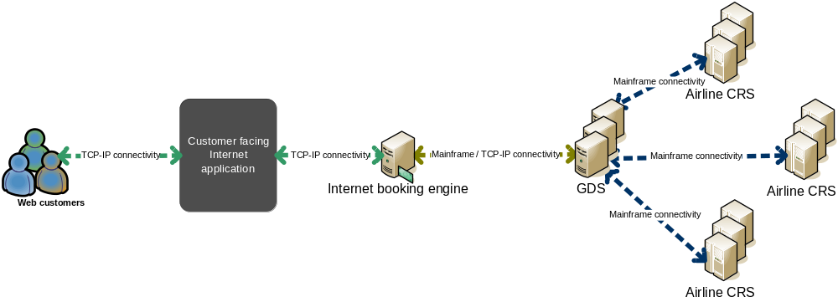
Booking engines (continued…)

Slide 22
Role of a booking engine
Acts as a bridge between Internet applications and legacy mainframe based CRSs and GDSs
Provides access to all airline (and non-air) data through a GDS
  Locations
  Schedules
  Fares
  Availability
  Passenger information
  Reservations

Slide 23
Role of a booking engine (continued…)
Provides support for modern programming languages like C++, Java, Microsoft .NET, PHP, etc.
Insulates Internet application developers from the intricacies of mainframe based systems
Allows Internet based applications to support large volumes of user traffic through concepts such as data caching
Supports internationalization and globalization

Slide 24
Role of a booking engine (continued…)
Allows airlines, travel agents and other players to store and manage static content for easy consumption in web applications
Allows storage, retrieval and application of business rules specific to scenarios
Provides a connector-based architecture for plugging in external sources of data
Additional features such as payment gateway integration, etc.

Slide 25
Major booking engines
Amadeus
  e-Commerce suite
    Offered as a software-as-a-service (SaS) or hosted solution
    Multiple built-in pages supporting Web 2.0 and CSS/XHTML that can be readily leveraged by small websites
    Modular, allowing purchase on individual modules (schedule, pricing, etc.)
    Does not support any standards
    Used by www.opodo.com
Datalex
  Travel Distribution Platform
    Offered as a software-as-a-service (SaS) or hosted solution
    Supports out-of-GDS fares, thereby reducing reliance on GDSs
    Supports OpenTravel (an open travel industry standard) where possible
    Used by many major airlines

Slide 26
Major booking engines (continued…)
Galileo
  Online Travel
    Offered as a software-as-a-service (SaS) or hosted solution
    Web services based architecture
    Highly stable solution
SITA
  Aero suite

Slide 27
Important terms in the booking process

Slide 28
Search types
Schedule search: When customer is interested only in checking flight timetables. Also known as Calendar search
Fare search: When a customer is interested in seat availability at (usually) the lowest price
Notes:
Key points
Direct flights: Aircrafts may have to stop to re-fuel or to offload cargo or to offload or take on passengers from intermediate points.

Slide 29
Flight types
Non-stop: No break in journey between the origin (location of first departure) and final destination (location of last touch-down)
Direct: One or more breaks in journey between the origin and final destination without passengers having to disembark from the aircraft
Stop-over: One or more breaks in journey between the origin and final destination with passengers having to disembark from aircraft either to change flights or to wait outside the aircraft. Sometimes referred to as Indirect
Change-of-gauge: A special type of stop-over flight where passengers have to change aircrafts at an intermediate point but the flight number remains the same
Notes:
Key points
Direct flights: Aircrafts may have to stop to re-fuel or to offload cargo or to offload or take on passengers from intermediate points.

Slide 30
Cabin classes
Allow an aircraft to be divided into multiple classes of service. Higher classes are usually more comfortable, come with additional services and are more expensive
Economy: The most basic class of service on most aircrafts. Provides basic seat accommodation and minimal in-flight catering service. Commonly purchased by leisure or family travellers. Known as Coach in North America
Business: Provides higher quality of service such as better seat accommodation and catering service. Commonly purchased by business travellers (executives)
First-class: Most expensive and most comfortable class, usually with personalized in-flight catering and entertainment service

Slide 31
Booking codes
Used by airlines to introduce price discrimination within a cabin class
26 booking codes are possible (A-Z)
Economy class booking codes: Y, B, M, H, N, G, K, L, O, Q, R, S, T, U, V, W, X
Business class booking codes: C, J, D, I, Z
First-class booking codes: F, A, P, R

Slide 32
Itinerary types
One-way: Itinerary covered by a single ticket and involves travel in a single geographical direction
Berlin
Chandigarh
Delhi
Frankfurt
Paris
Notes:
Key points
The itinerary origin is shown as a circle while direction of travel is indicated using an arrow.

Slide 33
Itinerary types (continued…)
Return: Itinerary covered by a single ticket and involves travel in two geographical directions and the origin is also the final destination
Chandigarh
Berlin
London
Frankfurt
Paris
Delhi

Slide 34
Itinerary types (continued…)
Origin open-jaw: Itinerary covered by a single ticket and involves travel in two geographical directions but origin is not the same as the final destination
Berlin
London
Frankfurt
Paris

Slide 35
Itinerary types (continued…)
Destination open-jaw: Itinerary covered by a single ticket and involves travel in two geographical directions, origin is the same as the final destination but there is a break mid-way
Berlin
London
Frankfurt
Paris
Notes:
Key points
The open-jaw segment may be traversed by any non-air means.

Slide 36
Itinerary types (continued…)
Double open-jaw: Combination of origin and destination open-jaws
Berlin
London
Frankfurt
Paris
Notes:
Key points
The open-jaw segment may be traversed by any non-air means.

Slide 37
Fare types (continued…)
Public: Available for purchase by anyone. Can be purchased from any channel. Fare rules are readily accessible to customers. Also known as Published fares
Private: Negotiated between airlines and travel agents. May be offered at a discount. Can be purchased only through the agent who negotiated the fare. Fare rules are available only through the associated agent. Also known as Negotiated fares

Slide 38
Fare types
Mileage based: Filed between two geographic locations. Contain restrictions on maximum mileage for an itinerary but no restrictions on route taken
Route based: Filed between two geographic locations. Contain restrictions on the route taken for an itinerary and may or may not have mileage restrictions

Slide 39
Fare types (continued…)
One-way: A mileage based fare that can be used to price all types of itineraries
Return: A mileage based fare that can be used to price only return or open-jaw itineraries
Half return: A mileage based fare that can be used to price return itineraries using the full fare or one-way itineraries using half the full fare

Slide 40
Recap and summary

Slide 41
Summary
Airline booking process consists of a series of steps
  Routing
  Schedule search
  Availability
  Faring
  Passenger confirmation
  Payment
Most steps in the airline booking process are handled by the GDS. Airline CRS is updated to keep it synchronized with the GDS

Slide 42
Summary (continued…)
Internet booking engines were created to bridge the impedance mismatch between mainframe based GDSs and Internet technologies
Most GDS companies offer one or more booking engines. Non-GDS companies like DataLex and SITA also offer popular booking engines
Internet application developers must access GDS through a booking engine

Slide 43
Questions?

